Slide 1
CS2040S Tutorial 3

Slide 2
Recap

Slide 3
Quick Sort
Following slides credit to Christian

Slide 4
Quick Sort
The idea:
Choose a pivot (and hope it’s not a bad one)
Partition the array into regions of smaller and larger than the pivot
Recursively sort the regions

Slide 5
Hoare’s Partition
The idea:
p
keys <= pivot
In progress
keys > pivot
p
keys <= pivot
keys > pivot
keys <= pivot
p
keys > pivot

Slide 6

Hoare’s Partition
Legend
Pivot
<= Pivot
> Pivot
About to swap
Post-swapping
Initialisation
100
90
80
70
60
50
40
30
20
10
Pivot
Low
High

Slide 7
Hoare’s Partition
Legend
Pivot
<= Pivot
> Pivot
About to swap
Post-swapping
40 is less than pivot!
100
90
80
70
60
50
40
30
20
10
Pivot
<= Pivot
Low
High

Slide 8
Hoare’s Partition
Legend
Pivot
<= Pivot
> Pivot
About to swap
Post-swapping
10 is less than pivot!
100
90
80
70
60
50
40
30
20
10
Pivot
<= Pivot
Low
High

Slide 9
Hoare’s Partition
Legend
Pivot
<= Pivot
> Pivot
About to swap
Post-swapping
Uh oh! 70 is not less than equal to the pivot. So we stop “increasing” up from ‘low’, and we start decreasing from ‘high’ after this
100
90
80
70
60
50
40
30
20
10
Pivot
<= Pivot
Low
High

Slide 10
Hoare’s Partition
Legend
Pivot
<= Pivot
> Pivot
About to swap
Post-swapping
80 is greater than the pivot!
100
90
80
70
60
50
40
30
20
10
Pivot
<= Pivot
> Pivot
Low
High

Slide 11
Hoare’s Partition
Legend
Pivot
<= Pivot
> Pivot
About to swap
Post-swapping
20 is less than the pivot! Now we have the two candidates to swap!
100
90
80
70
60
50
40
30
20
10
Pivot
<= Pivot
> Pivot
Low
High

Slide 12
Hoare’s Partition
Legend
Pivot
<= Pivot
> Pivot
About to swap
Post-swapping
So we shall swap and...
100
90
80
70
60
50
40
30
20
10
Pivot
<= Pivot
> Pivot
Low
High

Slide 13
Hoare’s Partition
Legend
Pivot
<= Pivot
> Pivot
About to swap
Post-swapping
The two elements we just swapped now belong to the correct partition! Let’s continue!
100
90
80
70
60
50
40
30
20
10
Pivot
<= Pivot
> Pivot
Low
High

Slide 14
Hoare’s Partition
Legend
Pivot
<= Pivot
> Pivot
About to swap
Post-swapping
30 is less than the pivot
100
90
80
70
60
50
40
30
20
10
Pivot
<= Pivot
> Pivot
Low
High

Slide 15
Hoare’s Partition
Legend
Pivot
<= Pivot
> Pivot
About to swap
Post-swapping
60 is greater than the pivot! So again, we stop incrementing the ‘low’
100
90
80
70
60
50
40
30
20
10
Pivot
<= Pivot
> Pivot
Low
High

Slide 16
Hoare’s Partition
Legend
Pivot
<= Pivot
> Pivot
About to swap
Post-swapping
100 is greater than the pivot
100
90
80
70
60
50
40
30
20
10
Pivot
<= Pivot
> Pivot
Low
High

Slide 17
Hoare’s Partition
Legend
Pivot
<= Pivot
> Pivot
About to swap
Post-swapping
90 is greater than the pivot
100
90
80
70
60
50
40
30
20
10
Pivot
<= Pivot
Low
High
> Pivot

Slide 18
Hoare’s Partition
Legend
Pivot
<= Pivot
> Pivot
About to swap
Post-swapping
The ‘low’ and ‘high’ has met! So we can stop doing the iterations
100
90
80
70
60
50
40
30
20
10
Pivot
<= Pivot
Low
High
> Pivot

Slide 19
Hoare’s Partition
Legend
Pivot
<= Pivot
> Pivot
About to swap
Post-swapping
As it turns out, 60 belonged to the > pivot partition
100
90
80
70
60
50
40
30
20
10
Pivot
<= Pivot
Low
High
> Pivot

Slide 20
Hoare’s Partition
Legend
Pivot
<= Pivot
> Pivot
About to swap
Post-swapping
Remember: our goal is to have the partition in the center! Which element should I swap with?
100
90
80
70
60
50
40
30
20
10
Pivot
<= Pivot
Low
High
> Pivot

Slide 21
Hoare’s Partition
Legend
Pivot
<= Pivot
> Pivot
About to swap
Post-swapping
30! Or in particular: one index less than ‘low’ or ‘high’
100
90
80
70
60
50
40
30
20
10
Pivot
<= Pivot
Low
High
> Pivot

Slide 22
Hoare’s Partition
Legend
Pivot
<= Pivot
> Pivot
About to swap
Post-swapping
And swap! (This is to satisfy the postconditions)
100
90
80
70
60
50
40
30
20
10
<= Pivot
Pivot
Low
High
> Pivot

Slide 23
Hoare’s Partition
Legend
Pivot
<= Pivot
> Pivot
About to swap
Post-swapping
Now we have successfully partitioned the array :D
100
90
80
70
60
50
40
30
20
10
<= Pivot
Pivot
Low
High
> Pivot

Slide 24
Analysis of Quicksort
(Refer to lecture slides for more details)

Slide 25
Analysis of Quicksort
(Refer to lecture slides for more details)
If we randomly choose the pivot:
Average Case: O(nlogn) time
Worst-Case: O(n²) time
Space: O(1) space because only swappings are required

Slide 26
Randomization
Why?

Slide 27
Randomization
Why?
Guarding against worst case

Slide 28
Randomization
Why?
Guarding against worst case
Better probability of success

Slide 29
Probability Theory for expected run time
Pr(heads) = p
Pr(tails) = (1 – p)

Slide 30
Probability Theory for expected run time
Pr(heads) = p
Pr(tails) = (1 – p)
How many flips to get at least one head?
E[X] = 1/p
Derived in lecture

Slide 31
Tutorial Time

Slide 32
Qn 1a
Suppose that the pivot choice is the median of the first, middle and last keys, can you find a bad input for QuickSort?

Slide 33
Qn 1 Answer
Yes! As long as we have a fixed pivot choice, the time complexity would remain at O(n^2) as it is always possible to find a bad input for the algorithm.

Slide 34
Qn 1 Answer
Yes! As long as we have a fixed pivot choice, the time complexity would remain at O(n^2) as it is always possible to find a bad input for the algorithm.
For example (the underlined section indicates the subarray that is currently being recursed on, bolded are the first, middle and last keys):
1st Partitioning : [8, 3, 2, 1, 5, 4, 6, 7, 9] (8 will be selected as the pivot)
2nd Partitioning : [7, 3, 2, 1, 5, 4, 6, 8, 9] (6 will be selected as the pivot)
3rd Partitioning : [4, 3, 2, 1, 5, 6, 7, 8, 9] (4 will be selected as the pivot)
4th Partitioning : [1, 3, 2, 4, 5, 6, 7, 8, 9] (2 will be selected as the pivot)

Slide 35
Qn 1b
Are any of the partitioning algorithms we have seen for QuickSort stable? Can you design a stable partitioning algorithm? Would it be efficient?

Slide 36
Qn 1b Answer
No, all partitioning algorithms are not stable.
But we can make them stable! How?

Slide 37
Qn 1b Answer
Create a new array with the original indices of the key
Original Array : [1, 2, 5, 3, 5, 3, 8, 7, 2]
New Array : [0, 1, 2, 3, 4, 5, 6, 7, 8]
When comparing elements, the new array would be used to disambiguate elements with equal keys, creating a “total ordering” between every key.
When comparing the 2s, sorting algorithm will check which value came first using the new array of original indices
Note: We use the not in-place quicksort algorithm

Slide 38
Qn 1b Answer
Original Array : [3, 2, 5, 1, 5, 3, 8, 7, 2]
New Array : [0, 1, 2, 3, 4, 5, 6, 7, 8]

Slide 39
Qn 1c
Consider a QuickSort implementation that uses the 3-way partitioning scheme (i.e. elements equal to the pivot are partitioned into their own segment).
i) If an input array of size n contains all identical keys, what is the asymptotic bound for QuickSort?

Slide 40
Qn 1c (i) Answer
O(n)
After first pass, no more unsorted elements

Slide 41
Qn 1c
Consider a QuickSort implementation that uses the 3-way partitioning scheme (i.e. elements equal to the pivot are partitioned into their own segment).
(ii) If an input array of size n contains k < n distinct keys, what is the asymptotic bound for QuickSort?

Slide 42
Qn 1c (ii) Answer
Maximum of k pivots that can be chosen → max height of recurrence tree is k
Assume worst case for every level O(n)
Runtime = n * k = O(nk)

Slide 43
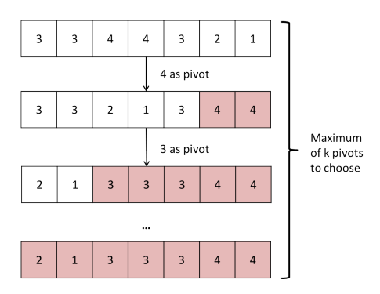
Qn 1c (ii) Answer
Example:
k = 4

Slide 44
Qn 1c (ii) Answer
Example:
k = 4

Slide 45
Qn 1c (ii) Answer
Example:
k = 4

Slide 46
Qn 1c (ii) Answer
Example:
k = 4

Slide 47
Qn 1c (ii) Answer
If pivot selection is guaranteed to be balanced, the asymptotic bound should be O(n log k)
* Think of each key as a single element

Slide 48
Qn 2a
Given an array A, decide if there are any duplicated elements in the array.

Slide 49
Qn 2a Answer
Sort → O(n log n)
Traverse array, check if i is same as i + 1 → O(n)
Overall: O(n log n)

Slide 50
Qn 2b
Given an array A, output another array B with all the duplicates removed. Note the order of the elements in B does not need to follow the same order in A. That means if array A is {3, 2, 1, 3, 2, 1}, then your algorithm can output {1, 2, 3}.

Slide 51
Qn 2b Answer
Similar to 2a
Sort → O(n log n)
Variable k to keep track of largest element encountered → O(n)
Remove if element at index i is identical to k
Update the value of k if not duplicate
Overall: O(n log n)

Slide 52
Qn 2c
Given arrays A and B, output a new array C containing all the distinct items in both A and B. You are given that array A and array B already have their duplicates removed.

Slide 53
Qn 2c Answer
Merge sort!
Sort both arrays in ascending order and do the merge step of merge sort
If element has already been added to array C, discard it
Overall: O(n log n)

Slide 54
Qn 2d
Given array A and a target value, output two elements x and y in A where (x+y) equals the target value.

Slide 55
Qn 2d Answer
Sort (again!)
Use two pointers, low and high
If the target is less than the required value, low++
If the target is greater than the required value, high--
Overall: O(n log n)

Slide 56
Qn 3 Child Jumble
Come up with an eﬃcient algorithm to match each child to their shoes.
Luckily, their feet (and shoes) are all of slightly diﬀerent sizes. Unfortunately, they are all very similar, and it is very hard to compare two pairs of shoes or two pairs of feet to decide which is bigger. As such, you cannot compare shoes to shoes or feet to feet.
The only thing you can do is to have a toddler try on a pair of shoes.
Other variations of this question: taste Hainanese Chicken Rice / nuts-and-bolts

Slide 57
Qn 3 Child Jumble
What are the constraints in this problem?
How should we compare children? (What is a feasible criteria)?
What algorithm would you use?
How fast is your algorithm?

Slide 58


Qn 3 Child Jumble
We can use quicksort!
The basic solution is to choose a random pair of shoes (e.g., the orange converse), and use it to partition the kids into “bigger” and “smaller” groups.
Larger feet
Smaller feet
pivot

Slide 59

Qn 3 Child Jumble
Along the way, you ﬁnd one kid (“Alex”) for whom the orange Converse ﬁt.
Larger feet
Smaller feet
pivot
Alex

Slide 60

Qn 3 Child Jumble
Then, Alex partitions the shoes.
Larger shoes
Smaller shoes
pivot “Alex”

Slide 61
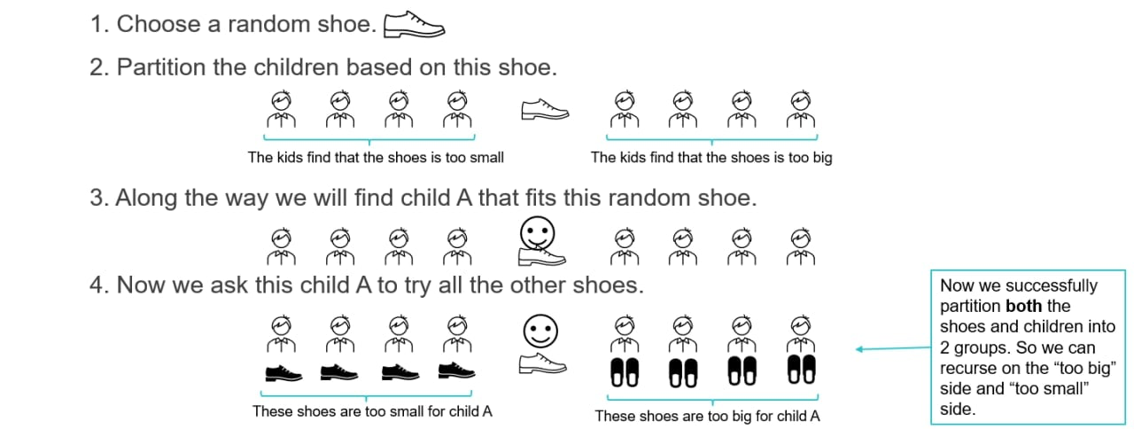
To summarize…

Slide 62
Qn 4
Quicksort is pretty fast. But that was with one pivot.
Can we improve it by using two pivots?
What about k pivots? What would the asymptotic running time be?

Slide 63
Qn 4 Answer
Sort the pivots?
Placing the item into the correct basket?
Example with 2 pivots:
Before partition: [57 8 42 75 29 77 38 24]
After partition: [8 24 42 38 29 57 75 77]
> 24
24<x<57
> 57

Slide 64
Qn 4 Answer
O(k log k) time to sort the pivots
O(n log k) time to place each item in the right bucket (using binary search)
Before partition: [57 8 42 75 29 77 38 24]
After partition: [8 24 42 38 29 57 75 77]
> 24
24<x<57
> 57

Slide 65
Qn 4 Answer
O(k log k) time to sort the pivots
O(n log k) time to place each item in the right bucket (using binary search)
Before partition: [57 8 42 75 29 77 38 24]
After partition: [8 24 42 38 29 57 75 77]
> 24
24<x<57
> 57

Slide 66
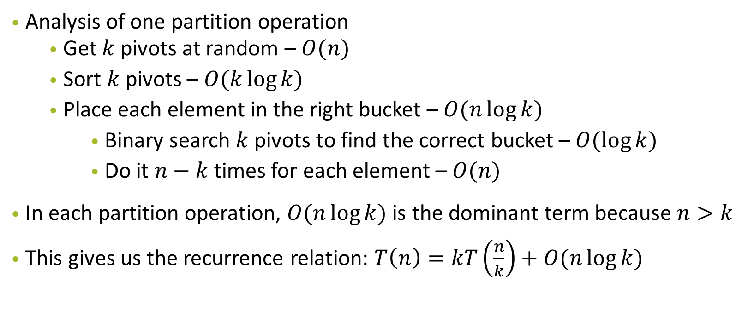
Qn 4 Answer

Slide 67
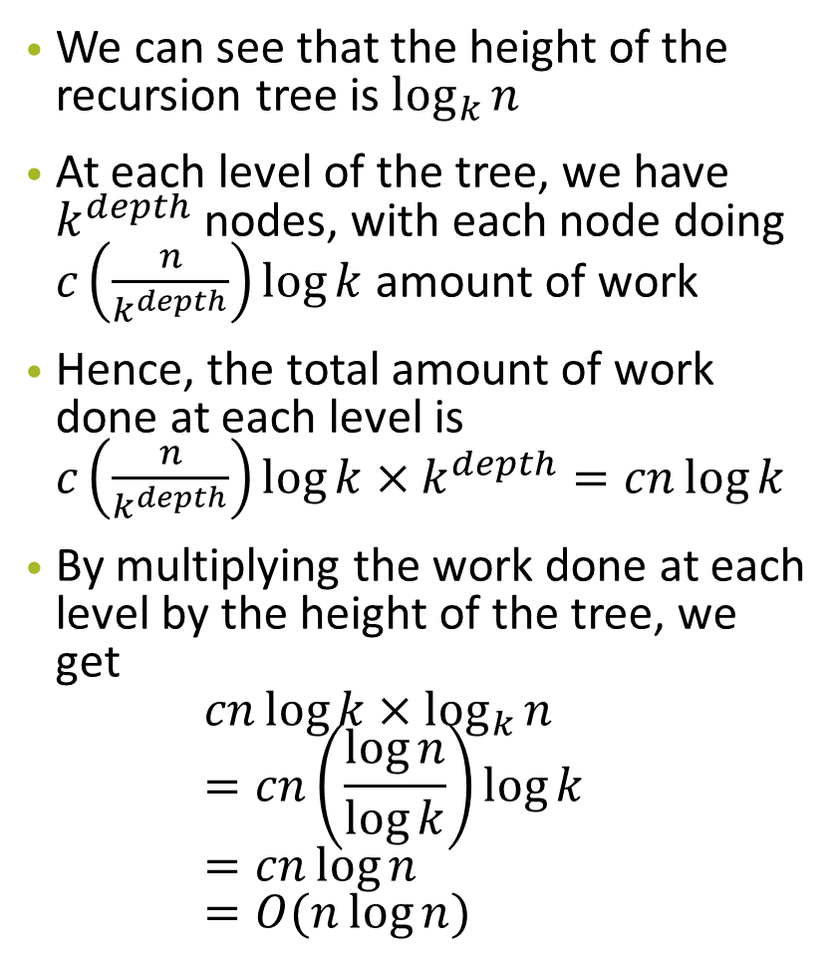
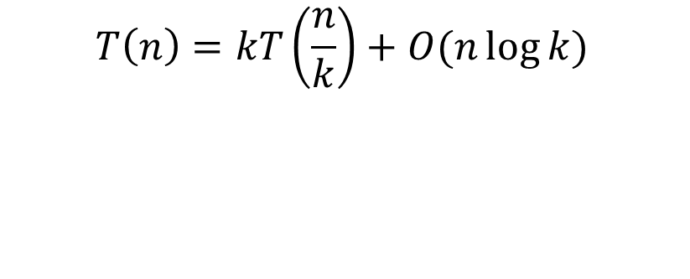
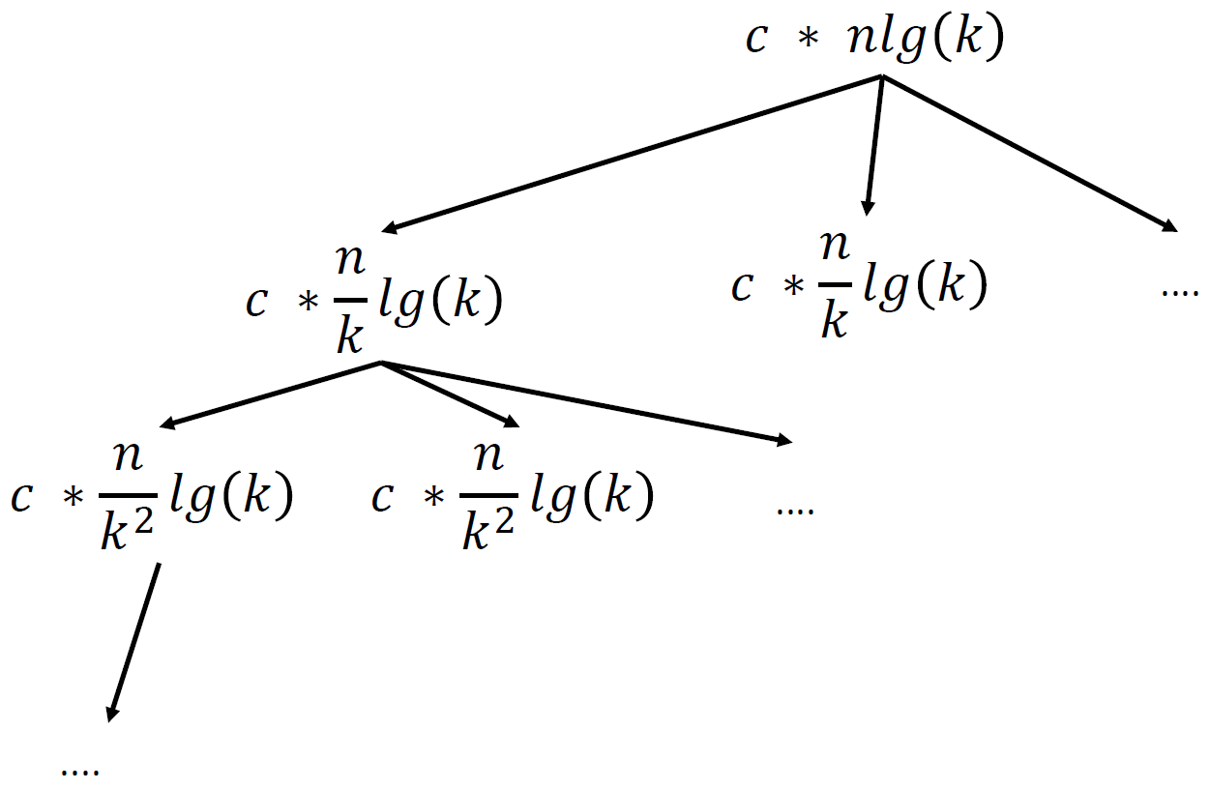
Qn 4 Answer

Slide 68
Qn 4 Answer
O(k log k) time to sort the pivots
O(n log k) time to place each item in the right bucket (using binary search)
Resulting recurrence: T(n) = kT(n/k) + O(n log k), as long as n > k
O(n log _{k} n log k) = O(n log n)
// no improvement!!
(and need to do partition in place → more complicated and more cost)

Slide 69
Qn 4 (2 pivot Quicksort Example)
3 segments: (Assuming pivot1 < pivot2)
elements < pivot1
elements >= pivot1 && <= pivot2
elements > pivot2

Slide 70
Qn 4 (2 pivot Quicksort Example)
[57 8 42 75 29 77 38 24]
57 and 24 are chosen as pivots
Sort them (so that other elements can binary search the segments to be placed in

Slide 71
Qn 4 (2 pivot Quicksort Example)
[57 8 42 75 29 77 38 24]
57 and 24 are chosen as pivots
Sort them (so that other elements can binary search the segments to be placed in
After first partitioning:
[8 24 42 38 29 57 75 77]

Slide 72
Qn 4 (2 pivot Quicksort Example)
[57 8 42 75 29 77 38 24]
57 and 24 are chosen as pivots
Sort them (so that other elements can binary search the segments to be placed in
After first partitioning:
[8 24 42 38 29 57 75 77]
Next: recurse in the left segment (8), middle segment (42 38 29), and right segment (75 77).

Slide 73
Qn 5 Integer Sort (a)
How to sort 0s and 1s efficiently?
Could it be in-place? Is it stable?
0, 1, 0, 1, 1, 1, 0, 0, 0, 1, 1, 0, 1, 0

Slide 74
Qn 5 Integer Sort (a)
How to sort 0s and 1s efficiently?
Could it be in-place? Is it stable?
Since there are only two "types" of elements in the array now, how could you simplify the problem?
0, 1, 0, 1, 1, 1, 0, 0, 0, 1, 1, 0, 1, 0

Slide 75
Qn 5 Integer Sort (a)
Use QuickSort partitioning with two pointers, one at each side.
0, 1, 0, 1, 1, 1, 0, 0, 0, 1, 1, 0, 1, 0
zero ptr

Slide 76
Qn 5 Integer Sort (a)
Use QuickSort partitioning with two pointers, one at each side.
0 1 0 1 1 1 0 0 0 1 1 0 1 0
zero ptr
find the first 1

Slide 77
Qn 5 Integer Sort (a)
Use QuickSort partitioning with two pointers, one at each side.
0 1 0 1 1 1 0 0 0 1 1 0 1 0
zero ptr
find the first 1
one ptr
find the first 0

Slide 78
Qn 5 Integer Sort (a)
Swap!
0 0 0 1 1 1 0 0 0 1 1 0 1 1
zero ptr
find the first 1
one ptr
find the first 0

Slide 79
Qn 5 Integer Sort (a)
Find the next pair that could be switched.
0 0 0 1 1 1 0 0 0 1 1 0 1 1
zero ptr
find the first 1
one ptr
find the first 0

Slide 80
Qn 5 Integer Sort (a)
Find the next pair that could be switched.
0 0 0 1 1 1 0 0 0 1 1 0 1 1
zero ptr
find the next 1
one ptr
find the next 0

Slide 81
Qn 5 Integer Sort (a)
Swap! (And repeat)
Runtime: O(n) - only going through the array once.
0 0 0 0 1 1 0 0 0 1 1 1 1 1
zero ptr
find the next 1
one ptr
find the next 0

Slide 82
Qn 5 Integer Sort (b)
Now consider sorting an array consisting of integers between 0 and M, where M is a small integer.
(This time, do not try to do it in-place; you can use extra space to record information about the input array and you can use an additional array to place the output in.)
0 1 2 2 1 4 3 4 3 3 1 3 2 0

Slide 83
Qn 5 Integer Sort (b)
First, go through the array once counting how many of each element you have.
• Then, go through the array and compute where the ﬁrst element for each value should go in the output array. For example, to ﬁnd out where the ﬁrst ‘3’ in the array goes, sum up how many 0’s, 1’s, and 2’s there are in the input array: if there are 5 ‘0’s, 3 ‘’1’s, and 4 ‘’2’s, then the very ﬁrst 3 is going to go in slot A[12] of the output array A (counting from zero). This can easily be computed from the array computed in the previous step.
• Treat this new array as a set of M pointers that point to the beginning of each block for each value. Now iterate through the input array and copy each item into the proper place indicated by the pointer. Then advance the pointer.

Slide 84
Qn 5 Integer Sort (b)
First, go through the array once counting how many of each element you have.
Element Value | Count
0 | 2
1 | 3
2 | 3
3 | 4
4 | 2

Slide 85
Qn 5 Integer Sort (b)
(2) Go through the array and compute where the ﬁrst element for each value should go in the output array.
Element Value | Count | Where the first index should be in output array
0 | 2 | Index 0
1 | 3 | Index 2 (=0+2)
2 | 3 | Index 5 (=2+3)
3 | 4 | Index 8 (=5+3)
4 | 2 | Index 12(=8+4)

Slide 86
(3) Now iterate through the input array and copy each item into the proper place indicated by the pointer. Then advance the pointer.
Element Value | Count | pointers that point to the beginning of each block for each value
0 | 2 | Index 0
1 | 3 | Index 2 (=0+2)
2 | 3 | Index 5 (=2+3)
3 | 4 | Index 8 (=5+3)
4 | 2 | Index 12(=8+4)

Slide 87
(3) Now iterate through the input array and copy each item into the proper place indicated by the pointer. Then advance the pointer.
Element Value | Count | Pointers that point to the beginning of each block for each value
0 | 2 | Index 0
1 | 3 | Index 2 (=0+2)
2 | 3 | Index 5 (=2+3)
3 | 4 | Index 8 (=5+3)
4 | 2 | Index 12(=8+4)
This takes M space to keep track of how many of each item there are, and M space to keep track of the pointers to each region of the array.

Slide 88
Qn 5 Integer Sort (c)
Consider the following sorting algorithm for sorting integers represent in binary:
First, use the in-place algorithm from part (a) to sort by the ﬁrst (high-order) bit.
First bit | Second bit | Third bits…
0 | 2 | xxxxxxxx
0 | 3 | xxxxxxxx
1 | 3 | xxxxxxxx
1 | 4 | xxxxxxxx
1 | 2 | xxxxxxxx

Slide 89
Qn 5 Integer Sort (c)
Now, sort the two parts using the same algorithm, but using the second bit instead of the ﬁrst. And then, sort each of those parts using the 3rd bit, etc.
First bit | Second bit | Third bits…
0 | 0 | xxxxxxxx
0 | 1 | xxxxxxxx
1 | 0 | xxxxxxxx
1 | 0 | xxxxxxxx
1 | 1 | xxxxxxxx

Slide 90
Qn 5 Integer Sort (c)
Assuming that each integer is 64 bits, what is the running time of this algorithm?
First bit | Second bit | Third bits…
0 | 1 | xxxxxxxx
0 | 0 | xxxxxxxx
1 | 0 | xxxxxxxx
1 | 1 | xxxxxxxx
1 | 0 | xxxxxxxx

Slide 91
Qn 5 Integer Sort (c)
Assuming that each integer is 64 bits, what is the running time of this algorithm?
Each level: O(n) time to sort
Repeat this process for 64 times (64 bits)
So it takes about 64n steps.
It is in-place, and just involves scanning the array 64 times, so it is fairly eﬃcient in a lot of way.

Slide 92
Qn 5 Integer Sort (c)
When do you think this sorting algorithm would be faster than QuickSort? If you want to, write some code and test it out.

Slide 93
Qn 5 Integer Sort (c)
When do you think this sorting algorithm would be faster than QuickSort? If you want to, write some code and test it out.
64 n < n log n
64 < log n
n > 2^64
Unfortunately, since QuickSort runs in approximately Θ(nlogn) time, this will only likely beat QuickSort when n > 2^64 , which is a bit large!

Slide 94
Qn 5 Integer Sort (d)
Can you improve on this by using the algorithm from part (b) instead to do the partial sorting? What are the trade-oﬀs involved?

Slide 95
Qn 5 Integer Sort (d)
Can you improve on this by using the algorithm from part (b) instead to do the partial sorting? What are the trade-oﬀs involved?
For example, you might divide each integer up into 8 chunks of 8 bits each.
This will still take O(n) time for each partial sort. Now the “recursion” only goes 8 levels deep.
Since the algorithm is not in-place, the trade-oﬀ we make is space: It will take 256 integers worth of space to do the sorting using the part (b) algorithm.
* If interested, look at radix sort!

Slide 96
Qn 6 Optional Question
What solutions did you ﬁnd for Contest 1 (Treasure Island)?

Slide 97
Qn 6 Optional Question
Here’s one approach for doing better:
• Choose a set of n/k keys that are still unexamined and put them in set S.
• Check if there is at least one correct key in S by using all the keys not in S to unlock the chest.
• If there is at least one correct key in S, then repeatedly use binary search to ﬁnd the correct keys in S. Each correct key you ﬁnd here will take O(log(n/k)) time.
• Mark the keys in set S as examined, and repeat with the remaining keys.

Slide 98
Qn 6 Optional Question
Since each correct key you ﬁnd takes O(log(n/k)) time, you will spend O(k log(n/k)) time doing binary searches for correct keys.
How many times will you query a set S and discover no correct keys?
There are only k diﬀerent sets with n/k keys, so this will take at most k queries. So the total number of queries is k log(n/k) + k. This is optimal, since Ω(k log(n/k)) is the best you can do.

Slide 99
Treasure Island (Kevin should be an artist tbh)
N keys, K correct keys
Try unlocking chest with >= K keys
If all keys are correct in the set, chest Is unlocked
Find the K keys

Slide 100
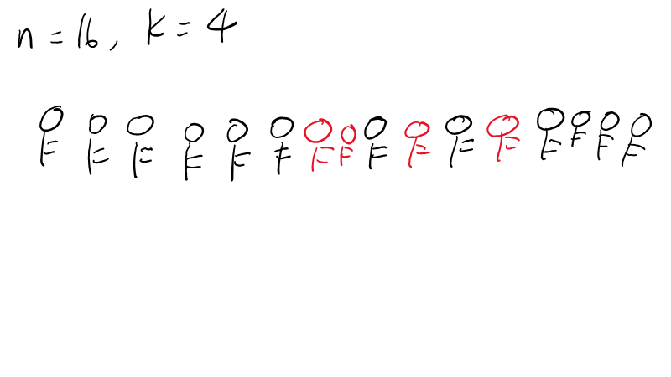

Slide 101
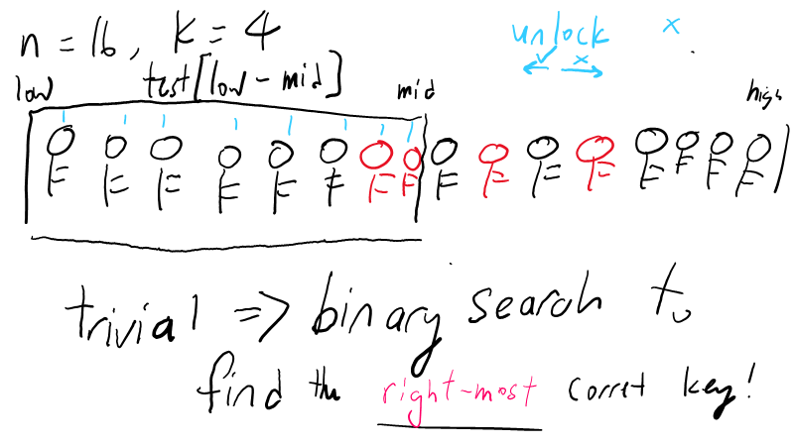

Slide 102
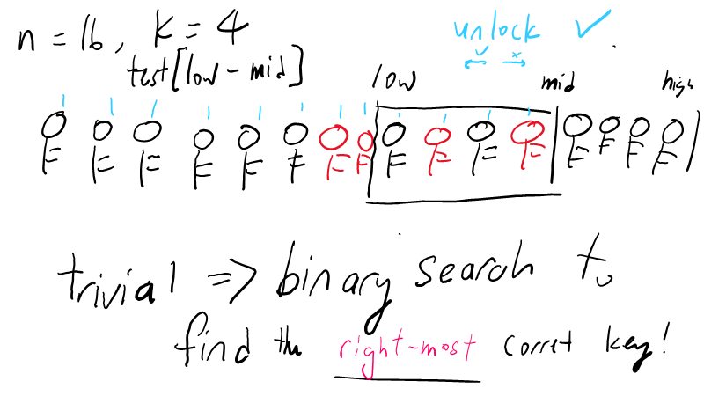

Slide 103
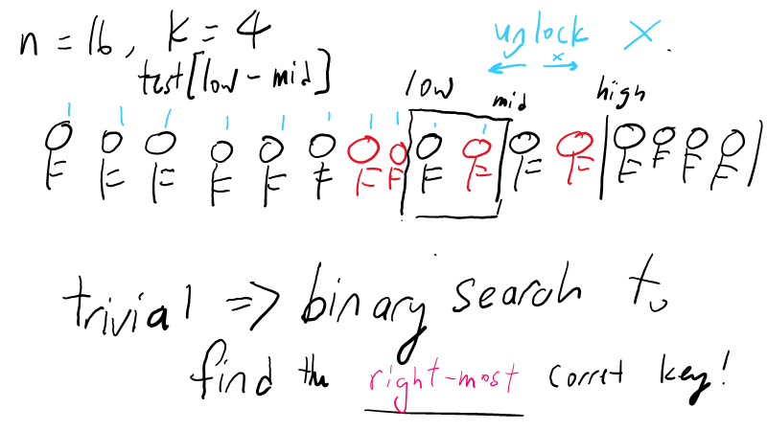

Slide 104
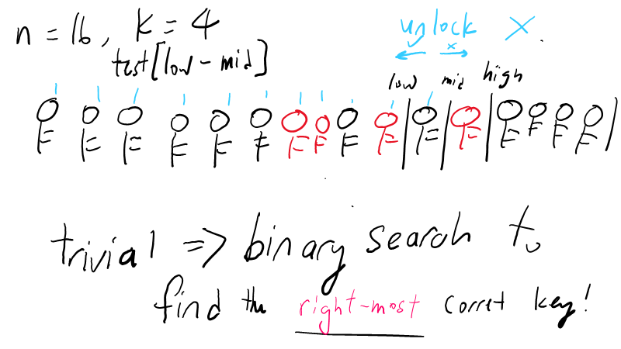

Slide 105
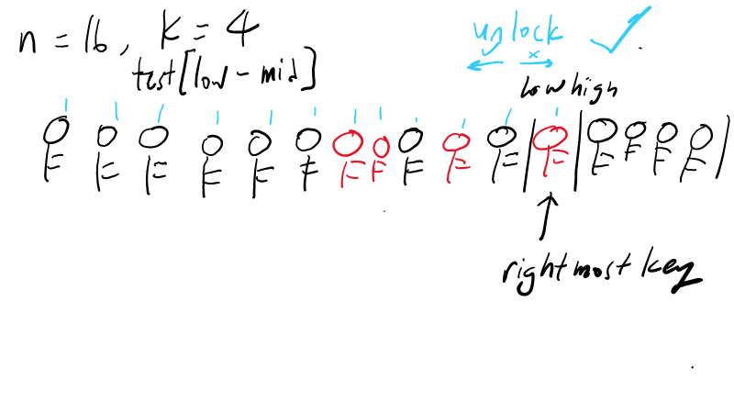

Slide 106
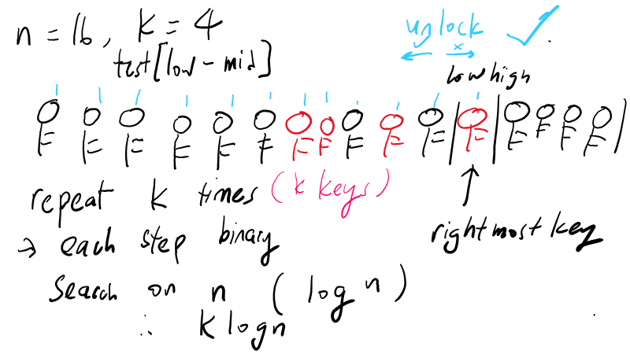

Slide 107
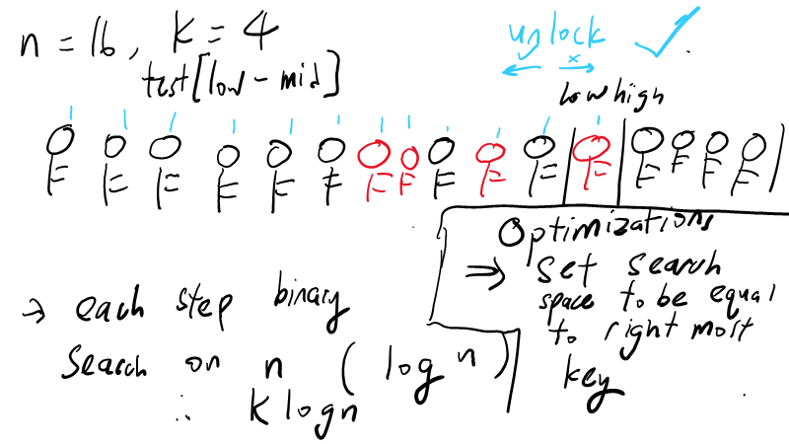

Slide 108
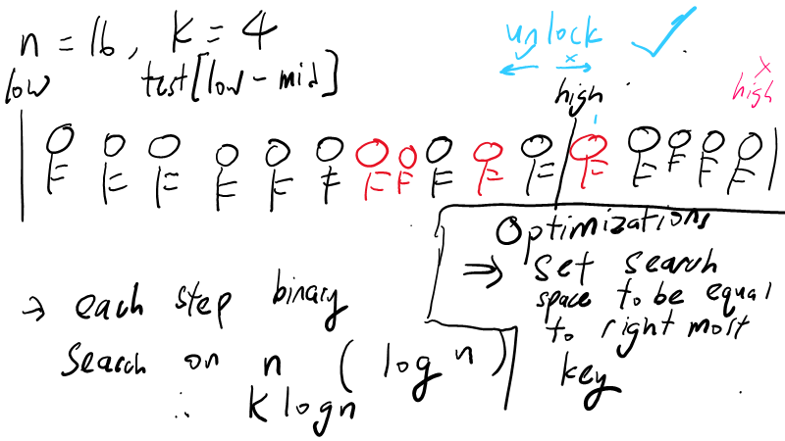

Slide 109
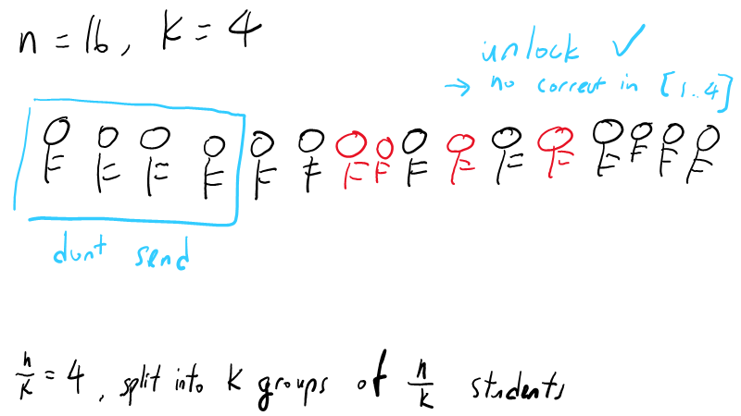

Slide 110
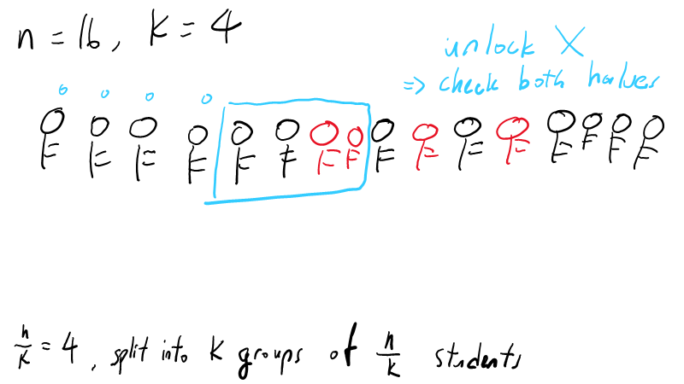

Slide 111
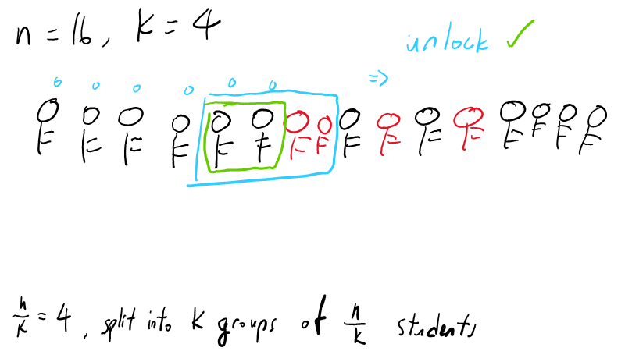

Slide 112
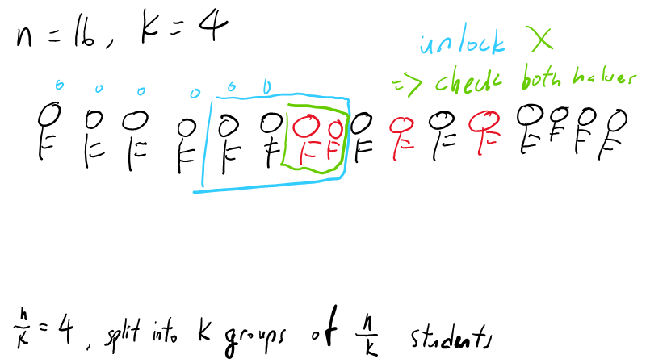

Slide 113
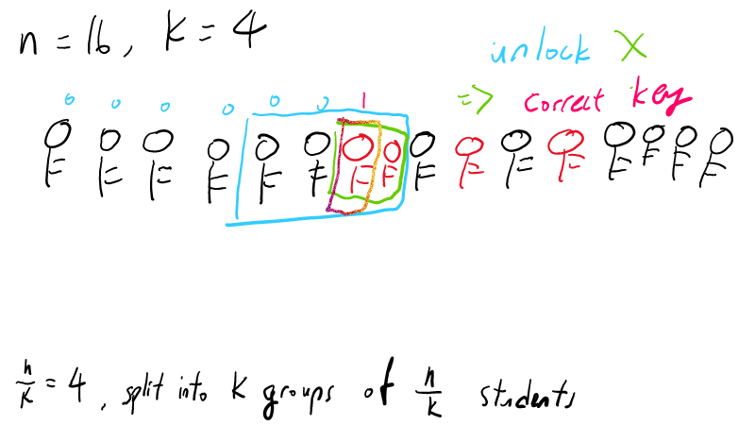

Slide 114
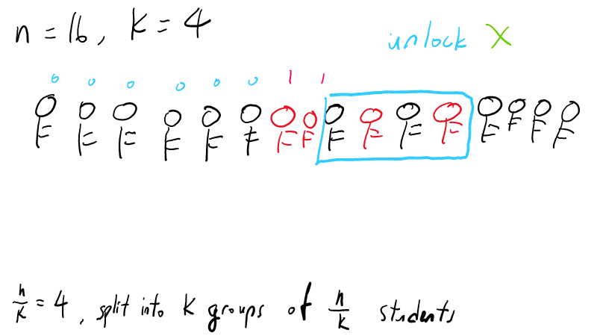

Slide 115
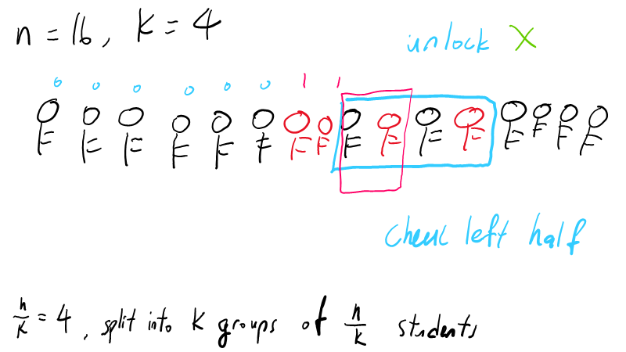

Slide 116
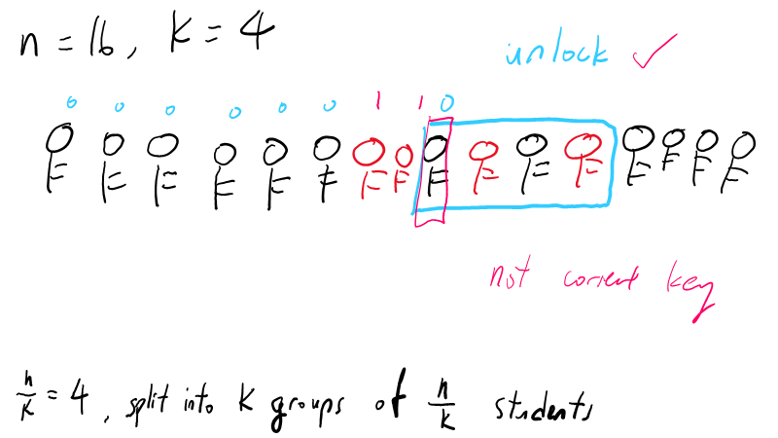

Slide 117
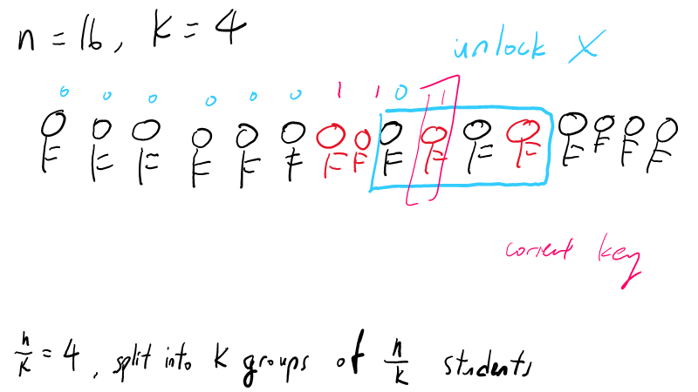

Slide 118
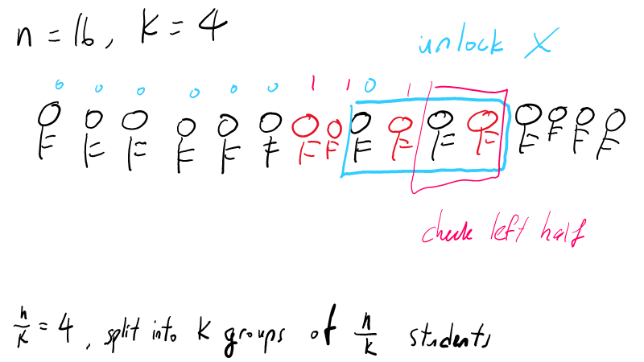

Slide 119
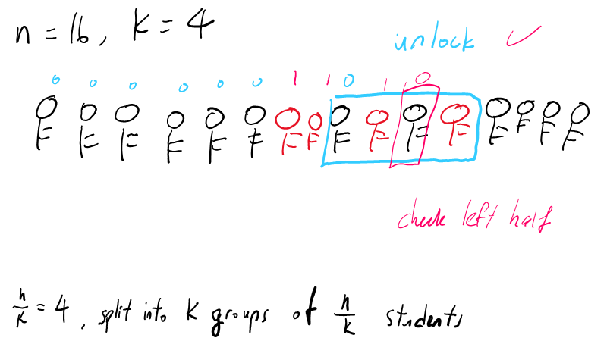

Slide 120
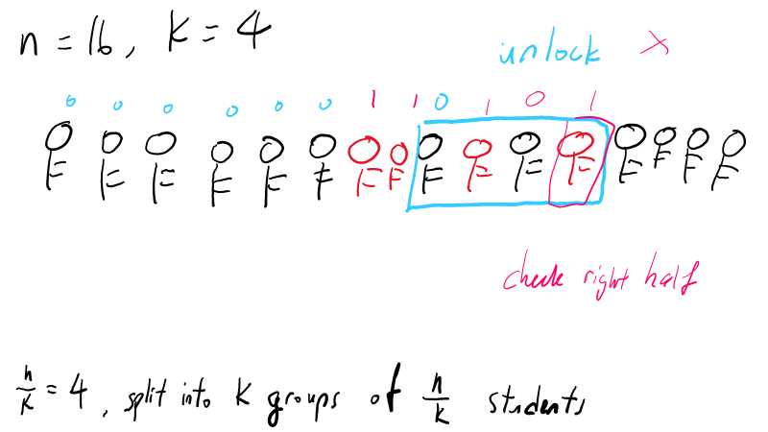

Slide 121
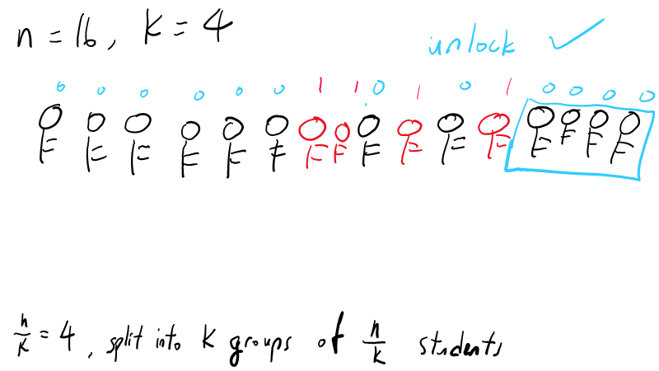

Slide 122
